Slide 1
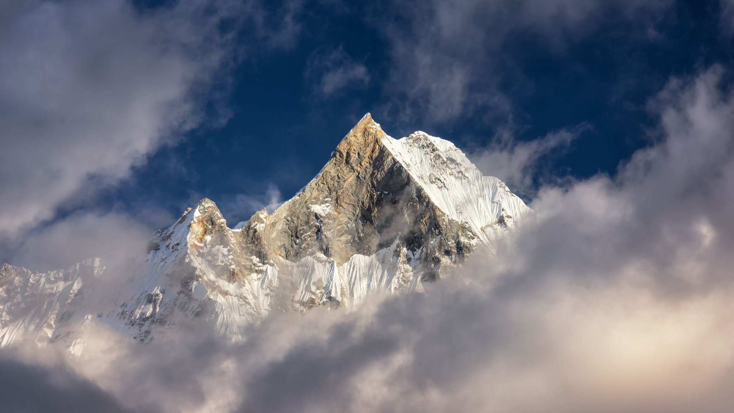
Nepali OCR
Using Tesseract OCR

Slide 2
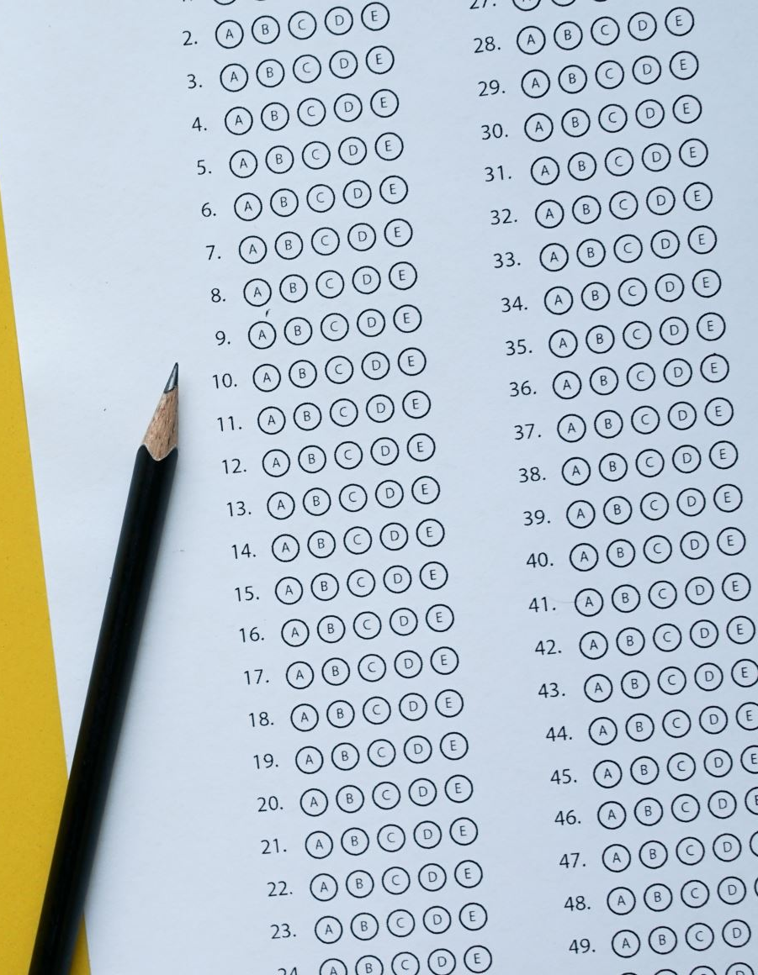
🌟 Introducing our Cutting-Edge OCR Solution 🌟
"Welcome to the Future of Nepali Document Digitization!
📃 Our Goal: Revolutionize the way Nepali documents are digitized and utilized.
What is OCR? Optical Character Recognition – Converting printed/handwritten text into digital format.
💡 Our Vision: Enhancing accessibility, accuracy, and efficiency in document processing.

Slide 3

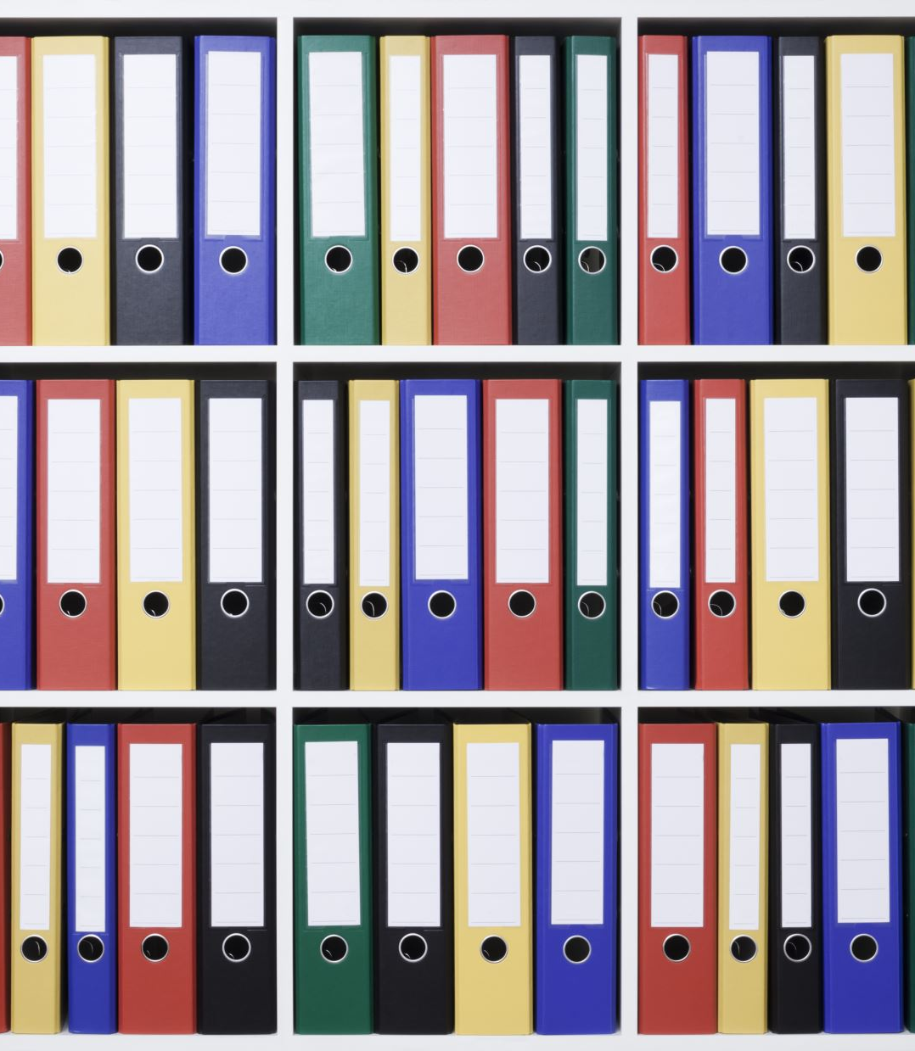
Significance
🔑 Enhanced Accessibility:
Break down language barriers by converting Nepali text into digital format.
Enable easy translation, text-to-speech, and other accessibility features.
📈 Increased Efficiency:
Accelerate document processing by automating text extraction.
Reduce manual data entry, saving time and resources.
🎯 Accurate Information Capture:
Minimize errors associated with manual transcription.
Maintain data integrity and improve reliability.

Slide 4
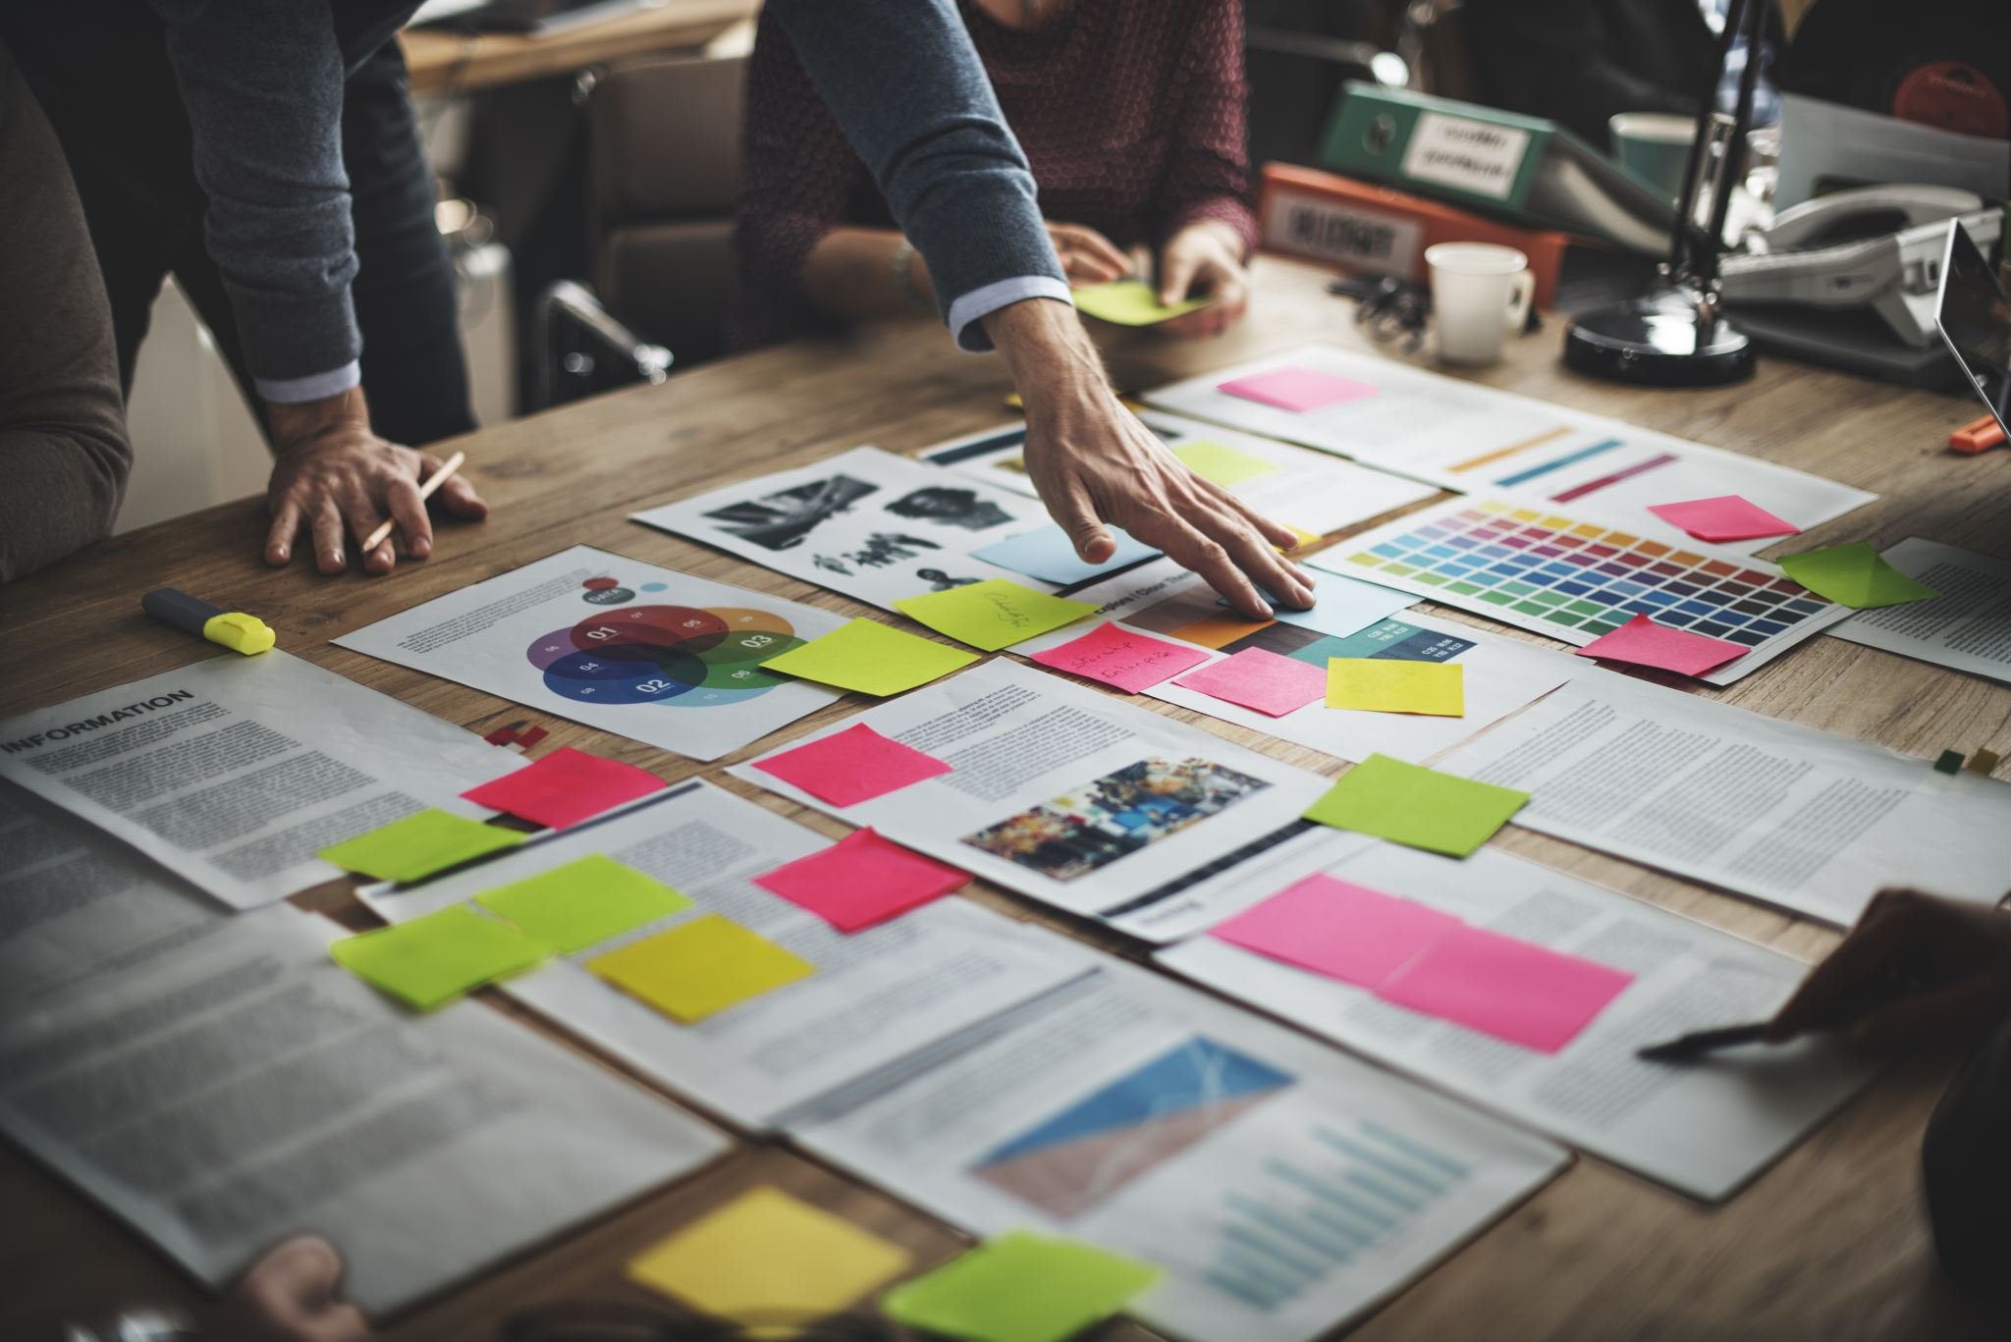
🌐 Seamless Data Integration:
Facilitate seamless integration of Nepali content into digital systems.
Enhance cross-platform compatibility and data sharing.
💼 Business and Government Applications:
Streamline administrative tasks, such as data entry and archiving.
Improve decision-making with searchable and analyzable digitized documents.
🌍 Global Outreach:
Extend the reach of Nepali content to a global audience.
Contribute to the preservation of Nepali culture and knowledge.

Slide 5

Implementation

Slide 6
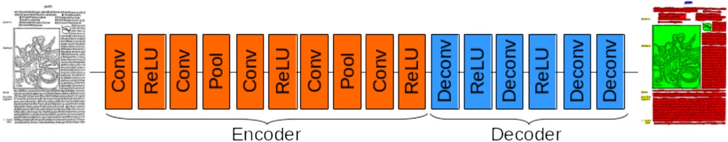

Slide 7
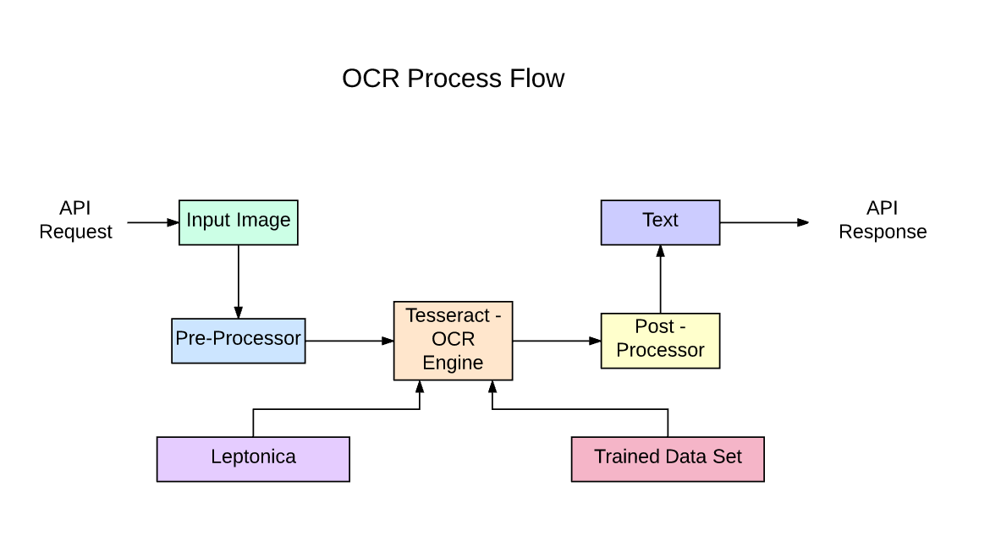

Slide 8
Preprocessing
Converting to gray image
Thresholding
sharpening
Removing background

Slide 9
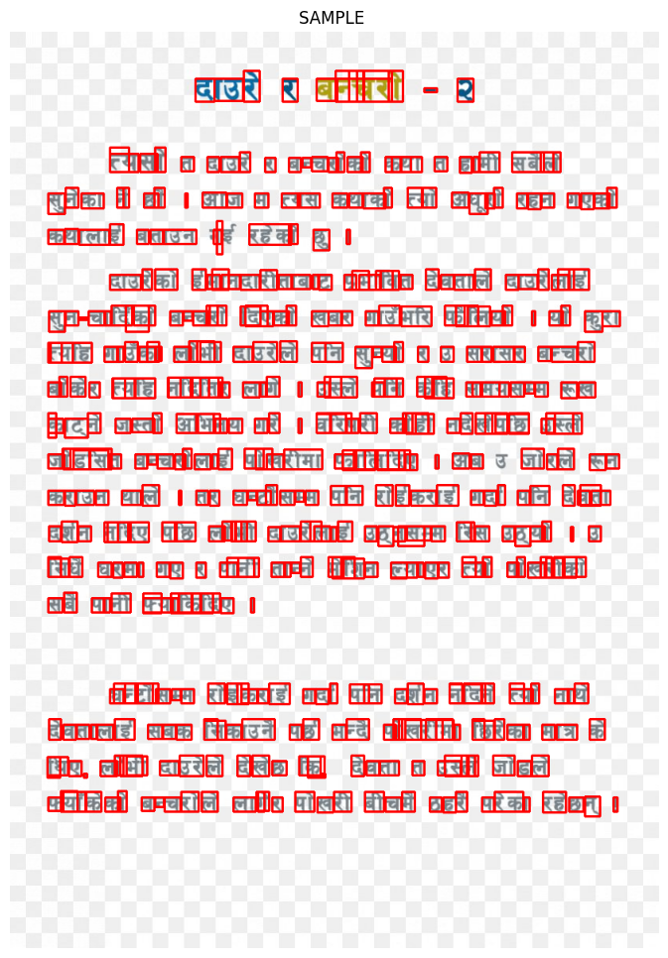

Slide 10

Evaluation Metrics
1.Character Error Rate (CER): - Based on the concept of Levenshtein distance
we count the minimum number of character-level operations
Required to transform the ground truth text into the OCR output.
2. Word Error Rate (WER):
Based on the concept of Levenshtein distance
where we count the minimum number of word-level operations
Required to transform the ground truth text into the OCR output.

Slide 11
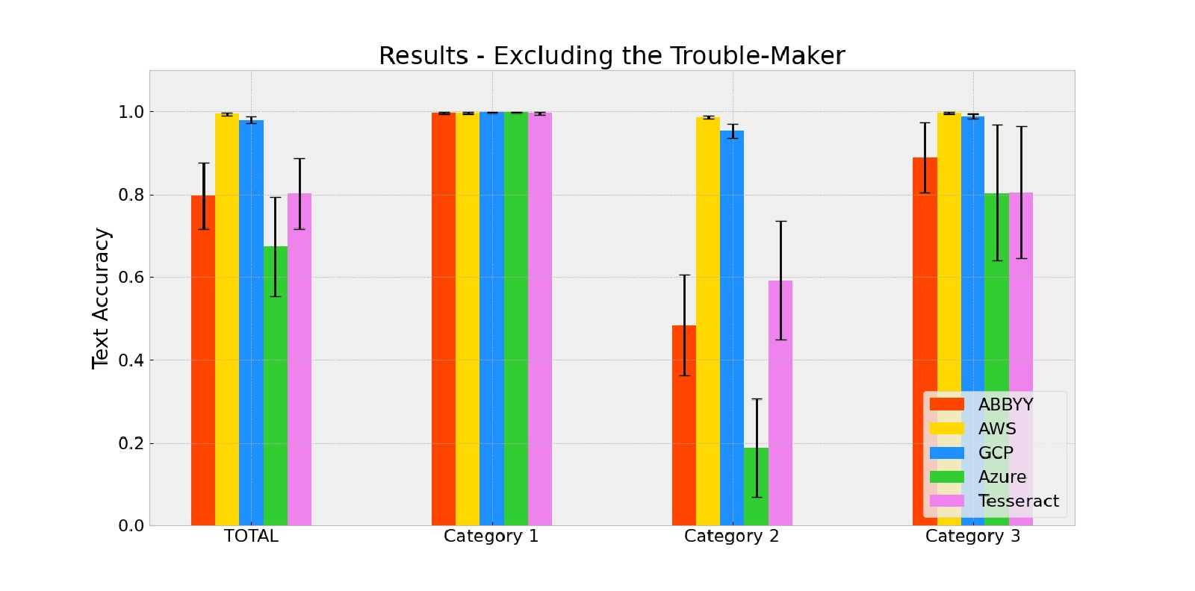
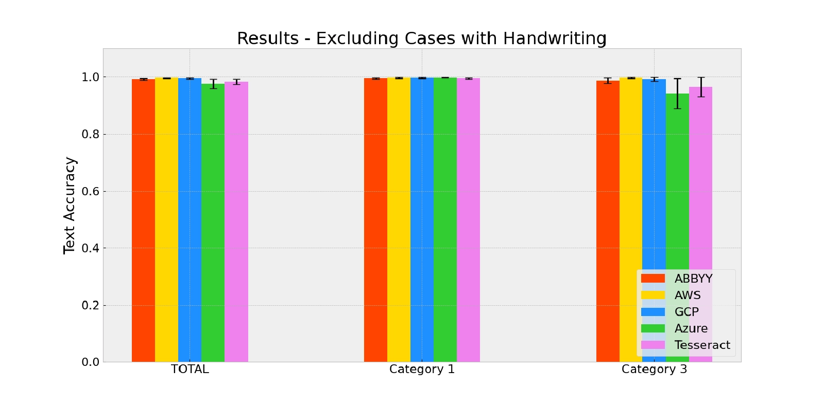
Benchmark

Slide 12
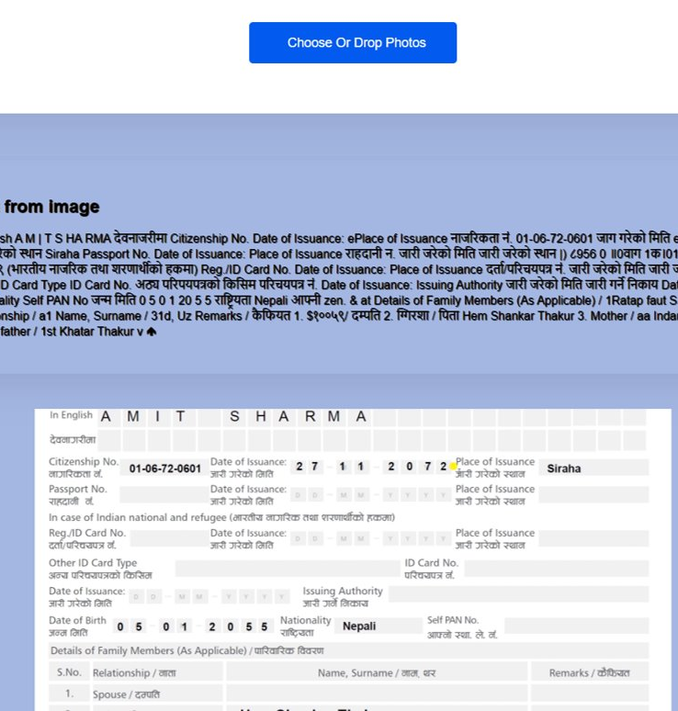

Deployment

Slide 13
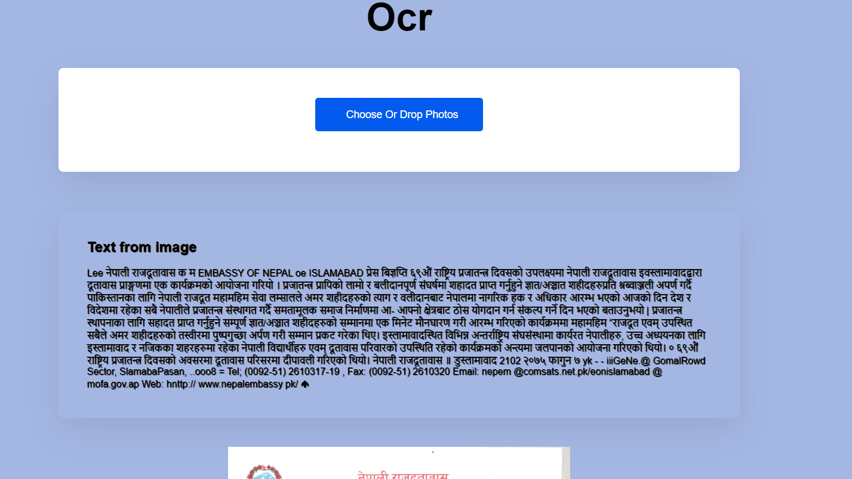

Slide 14
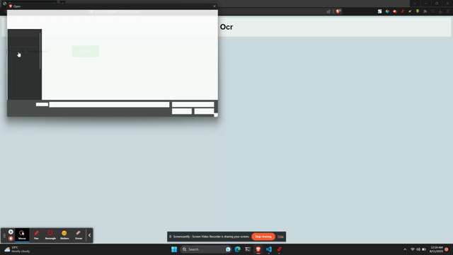

Slide 15
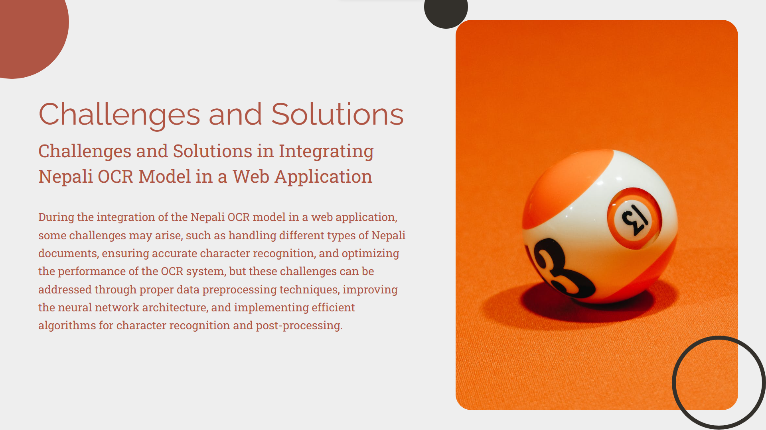

Slide 16

Limitations
🛑 Handwriting Variability
📖 Complex Layouts
👁️‍🗨️ Image Quality
🔌 Dependency on Technology
🚧 Handling Graphics(logos and memes)

Slide 17
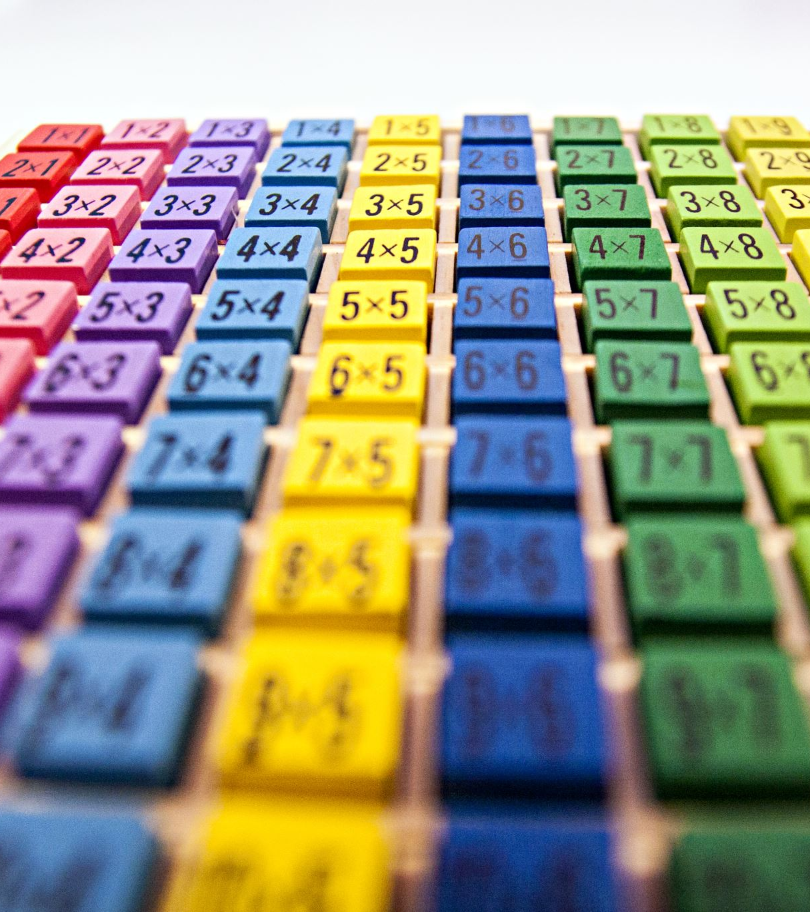
Another Approach.
Classifier
Segmentation and cropping
Feeding each individual letters to classify

Slide 18
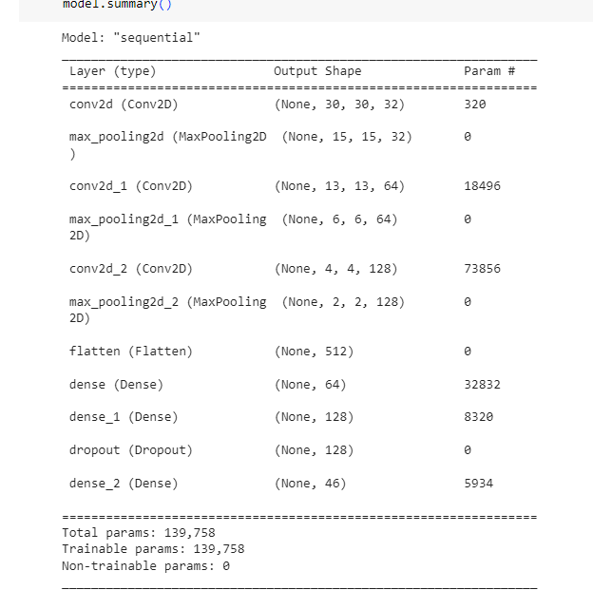
Classifier
Data set: https://www.kaggle.com/datasets/ashokpant/devanagari-character-dataset-large

Slide 19
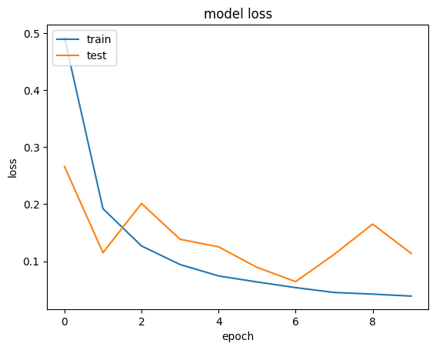
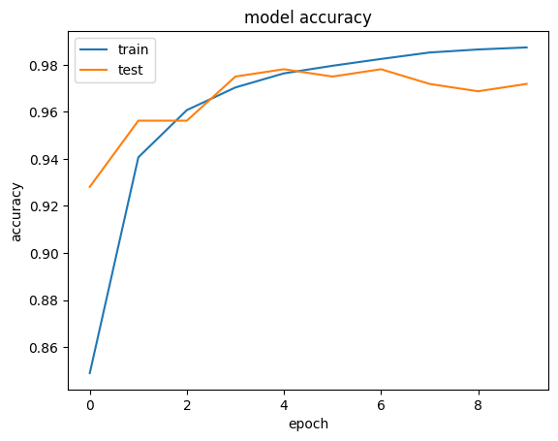
Training history

Slide 20
Challenges
Because of small size of dataset, the model didn't generalized well.
All the pictures are black and white, so transfer learning was challenging as well.

Slide 21
Segmentation and cropping
The picture is first cropped to keep the region containing the letters.
Then the letters are segmented using cv2 according to the density
Then the individual letters are cropped.

Slide 22
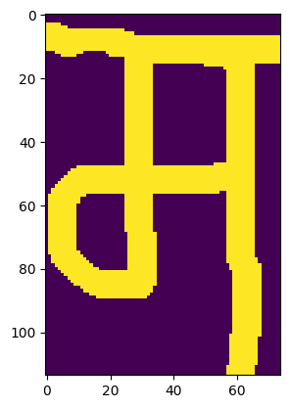
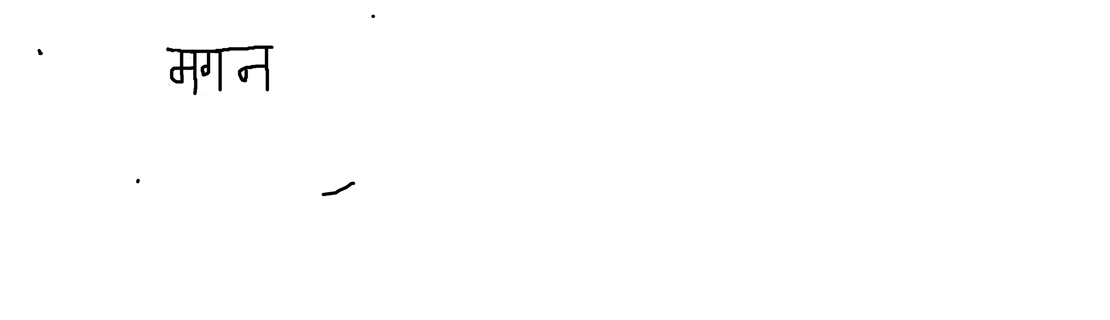
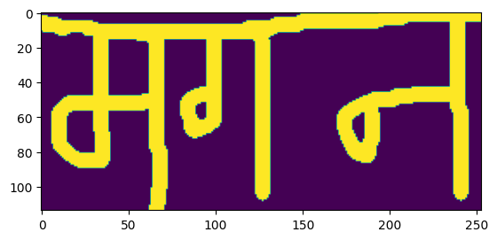
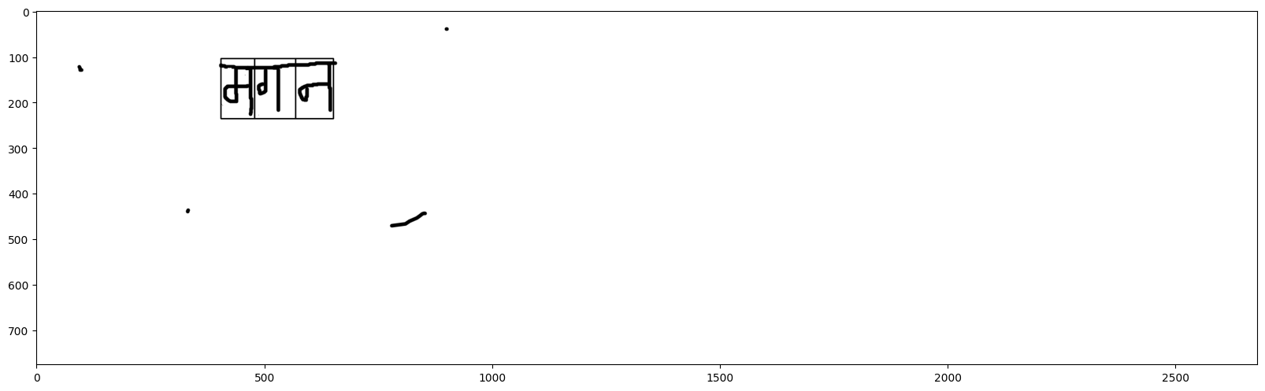
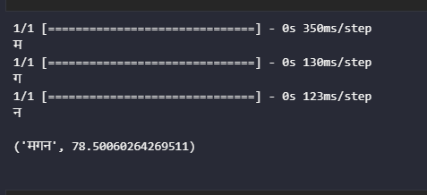

Slide 23
Future Prospects
Segmentation using yolo
Better classifier with all varieties of letters

